Slide 1


Pain
Dr. massara ghassan
Physiology Department
College of Medicine\ University of Basrah

Slide 2
Objectives
What is pain?
Types of painful stimuli.
3. Pain receptors
4. Nerve fibers that transmit pain signals.
Classification of pain
Pain analgesia system
University of Basrah-College of Medicine-Physiology Department
1

Slide 3
Pain is a protective mechanism which occurs when tissues being damaged.
In response to:
Painful stimuli
Even by simple activation , like sitting , in sitting in the same position for a long time.
University of Basrah-College of Medicine-Physiology Department
2

Slide 4
Sitting for a long time
compression on the tissues
lack of blood flow
person change his position
tissue destruction
Ischemia
University of Basrah-College of Medicine-Physiology Department
3

Slide 5
Painful stimuli
3 Types of Stimuli
. Mechanical
. Thermal
. Chemical
University of Basrah-College of Medicine-Physiology Department
4

Slide 6
How theses Stimuli Produce pain??
pain receptors
Are all free nerve endings
They are widespread in the superficial layers of the skin as well as in certain internal tissues
University of Basrah-College of Medicine-Physiology Department
5

Slide 7
Three Types of pain receptors
1. Mechanical nociceptors
Strong pressure (e.g from a sharp object)
2. Thermal nociceptors
Skin temperatures above 45c
Severe cold
3. Chemically sensitive nociceptors
Various agents like bradykinin , histamine, high acidity and environmental irritant.
University of Basrah-College of Medicine-Physiology Department
6

Slide 8
Classification of pain
Fast pain :
Bright, sharp localized pain.
Plays an important rule in making the person react immediately to remove himself or herself from the stimulus.
Slow pain :
Painful stimuli followed by a dull intense, diffuse, and unpleasant feeling ( slow (chronic) pain)
Tends to become greater overtime and makes the person keep trying to relieve the cause of the pain .
University of Basrah-College of Medicine-Physiology Department
7

Slide 9
Fast pain
Mechanical, thermal nociceptors
Type Aδ fibers
Neurotransmitter: Glutamate.
Slow pain
Mechanical, thermal, chemical
Type C fibers
Neurotransmitter is : substance p
University of Basrah-College of Medicine-Physiology Department
8

Slide 10
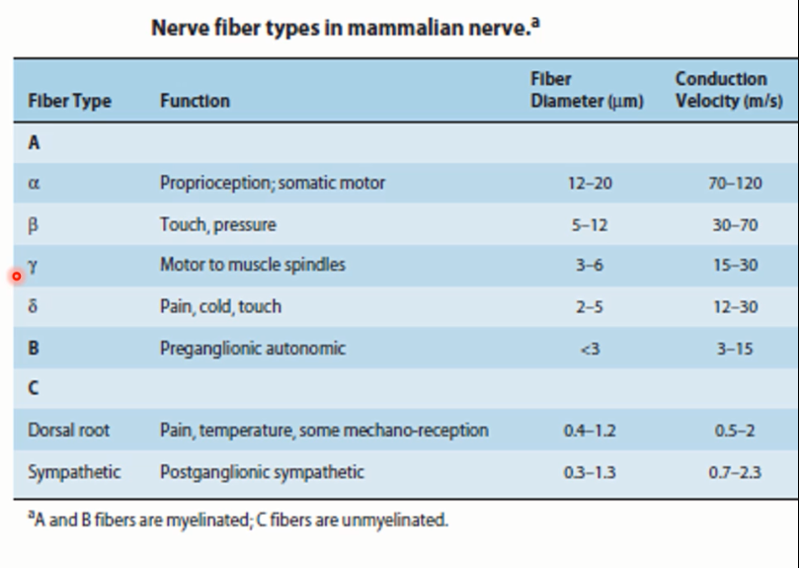
University of Basrah-College of Medicine-Physiology Department
9

Slide 11
Pain also classified in to
Superficial pain
Visceral pain
Deep pain
University of Basrah-College of Medicine-Physiology Department
10

Slide 12
Deep pain
Come from deep tissues like fascia, muscles and bones
There is little rapid , bright pain , because of relative deficiency of A delta nerve fibers in deep structures.
Deep and visceral pain are poorly localized , nauseating, and frequently associated with sweating and changes in blood pressure
University of Basrah-College of Medicine-Physiology Department
11

Slide 13
Visceral pain
Come from the viscera of the body
Poorly localized unpleasant and associated with nausea and autonomic symptoms
Visceral pain often radiates or is referred to other areas.
Highly localized types of damage to the viscera seldom cause severe pain.(surgeon can cut the gut entirely)
Conversely, any stimulus that causes diffuse stimulation of pain nerve endings throughout a viscous causes severe pain e.g ischemia.
University of Basrah-College of Medicine-Physiology Department
12

Slide 14
Nociceptors
a. Can be activated by strong pressure, severe cold, severe heat and chemicals
b. Are specialized structures located in the skin and joints only.
c. Are innervated by Type B nerve fibers
d. All of the above
University of Basrah-College of Medicine-Physiology Department
13

Slide 15
Referred pain
A person feels pain in a part of the body that is fairly remote from the tissue.
Best known examples:
1. Referred of cardiac pain to the inner aspect of the left arm
2. Pain in the tip of shoulder caused by irritation of the central portion of the diaphragm
University of Basrah-College of Medicine-Physiology Department
14

Slide 16
Mechanism of referred pain
The Dermatomal rule:
Pin is referred to structures that developed from the same embryonic segment or dermatome.
Convergence_ projection theory:
Convergence of somatic and visceral pain fibers on the same second order neurons.
University of Basrah-College of Medicine-Physiology Department
15

Slide 17
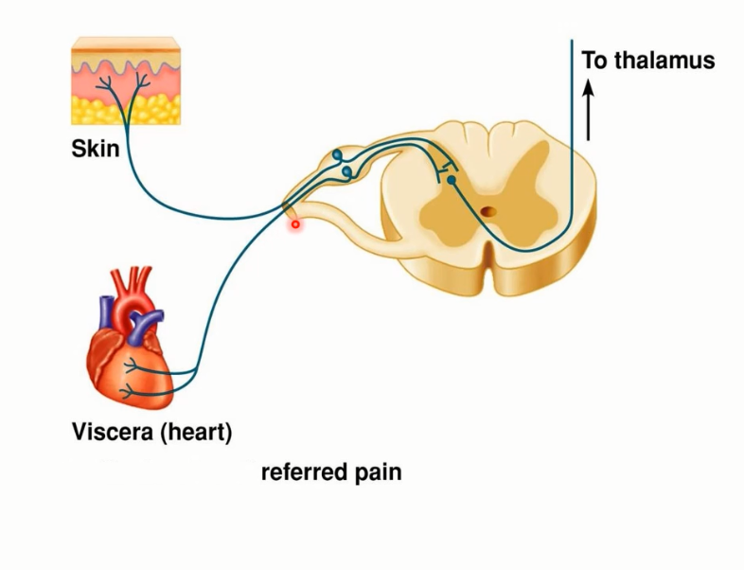
University of Basrah-College of Medicine-Physiology Department
16

Slide 18
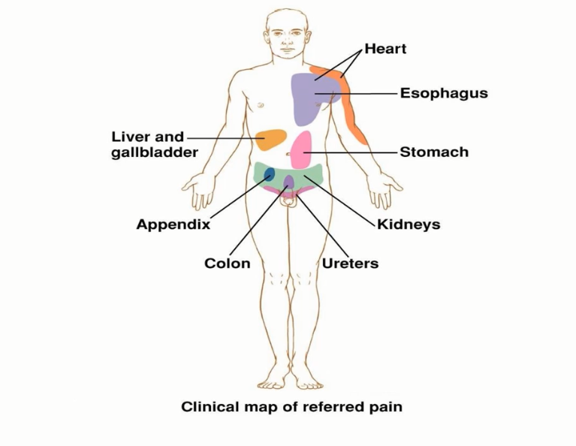
University of Basrah-College of Medicine-Physiology Department
17

Slide 19
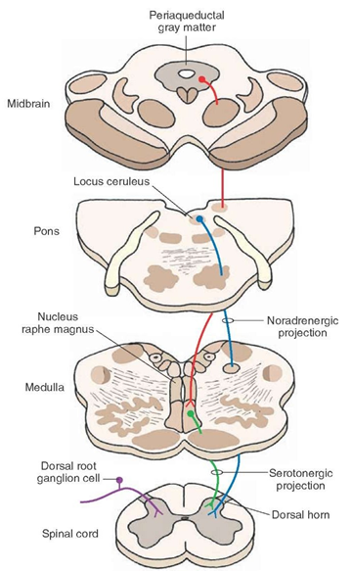
Analgesia System
Periaqueductal gray and periventricular areas
Raphe Magnus nucleus and nucleus reticularis paragigantocellularis
Pain inhibitory complex
University of Basrah-College of Medicine-Physiology Department
18
Notes:
Analgesia System
The degree to which a person reacts to pain varies tremendously. This results partly from a capability of the brain itself to suppress input of pain signals to the nervous system by activating a pain control system, called an analgesia system.
The analgesia system is consists of three major components:
(1) The periaqueductal gray and periventricular areas and portions of the third and fourth ventricles. Neurons from these areas secrete enkephalin at their endings at the raphe magnus nucleus .
(2) the raphe magnus nucleus located in the lower pons and upper medulla, and the nucleus reticularis paragigantocellularis, located in the medulla. Neurons from these nuclei secrete srotonin at their endings at the pain inhibitory complex
(3) a pain inhibitory complex located in the dorsal horns of the spinal cord. The serotonin causes the pain inhibitory complex to secrete enkephalin. The enkephalin is believed to cause both presynaptic and postsynaptic inhibition of incoming type C and type A δ pain fibers where they synapse in the dorsal horns. Thus, the analgesia system can block pain signals at the initial entry point to the spinal cord.
Electrical stimulation to periaqueductal gray area or in the raphe magnus nucleus leads to suppression of strong pain signals enter through dorsal spinal root.

Slide 20
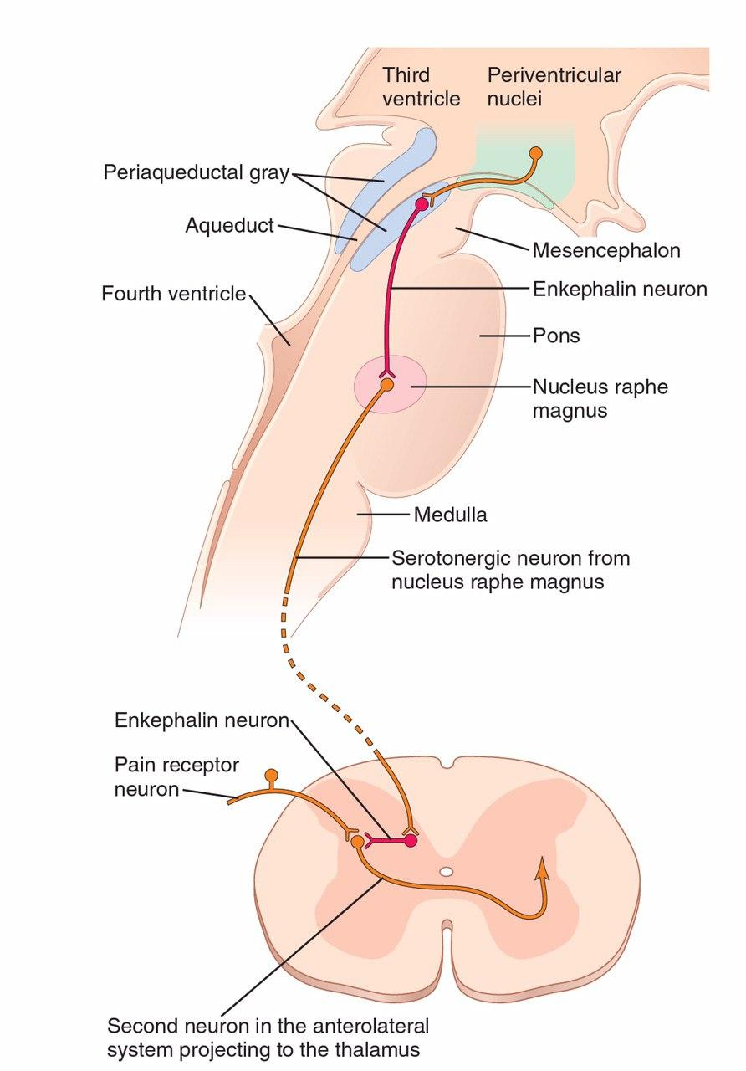
Enkephalin cause inhibition of incoming type C and type A δ pain fibers
19
University of Basrah-College of Medicine-Physiology Department

Slide 21

Inhibition of Pain Transmission by Simultaneous Tactile stimulation
mechanoreceptive
tactile receptor
Lateral inhibition
pain
University of Basrah-College of Medicine-Physiology Department
20
Notes:
Inhibition of Pain Transmission by Simultaneous Tactile
Stimulation of large type Aβ sensory fibers from peripheral tactile receptors can depress transmission of pain signals from the same body area. This presumably results from local lateral inhibition in the spinal cord. It explains why such simple maneuver as rubbing the skin near painful areas is often effective in relieving pain.

Slide 22
Some Clinical Abnormalities
Hyperalgesia
an exaggerated response to a noxious stimulus
Allodynia
a sensation of pain in response to a stimulus, that dose not normally elicit pain.
University of Basrah-College of Medicine-Physiology Department
21
Notes:
Some Clinical Abnormalities
Hyperalgesia and allodynia
Hyperalgesia is an exaggerated response to a noxious stimulus, whereas allodynia is a sensation of pain in response to an innocuous stimulus. An example of allodynia is the painful sensation from a warm shower when the skin is damaged by sunburn

Slide 23
Thank You

